Slide 1





Automatic assembly of large-scale signalling networks
Tanvi Ranjan, M.Sc.
European Institute for Systems Biology and Medicine
CNRS-ENS-UCBL-INSERM, CIRI UMR5308, Lyon, France
Notes:
1) Make clear this is literature-based / knowledge-based. Make sure that literature-based reconstruction are mentioned: it might not be obvious for everyone what is the difference with IPA.
2) Demonstrate what mechanistic is: as previously – step by step – with an example of a signalling pathways.
3) Invite for collaboration: clear message, contact information: a) groups that work on a particular disease, b) groups that work on particular systems / pathways.
4) More about the “quality stamp” - how we communication with experts.
5) Curation process: the quality question

Slide 2
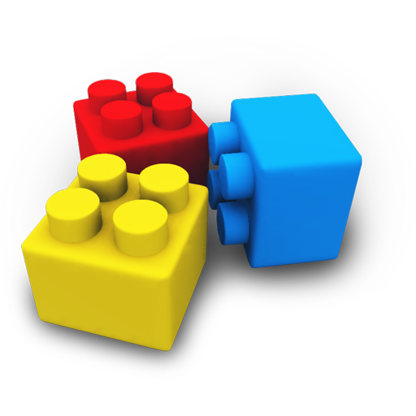
Automatically generated disease maps
Domain expertise
PubMed Search
MetaCore
Pathway Maps
REACTOME
PANTHER
RECON X
1
WHAT PATHWAYS TO INCLUDE?
disease map
2
HOW TO MERGE PATHWAYS?
3
Automatic generation of maps with ‘human-like’ layout
BUILDING BLOCKS
(reusable pathways)

Slide 3
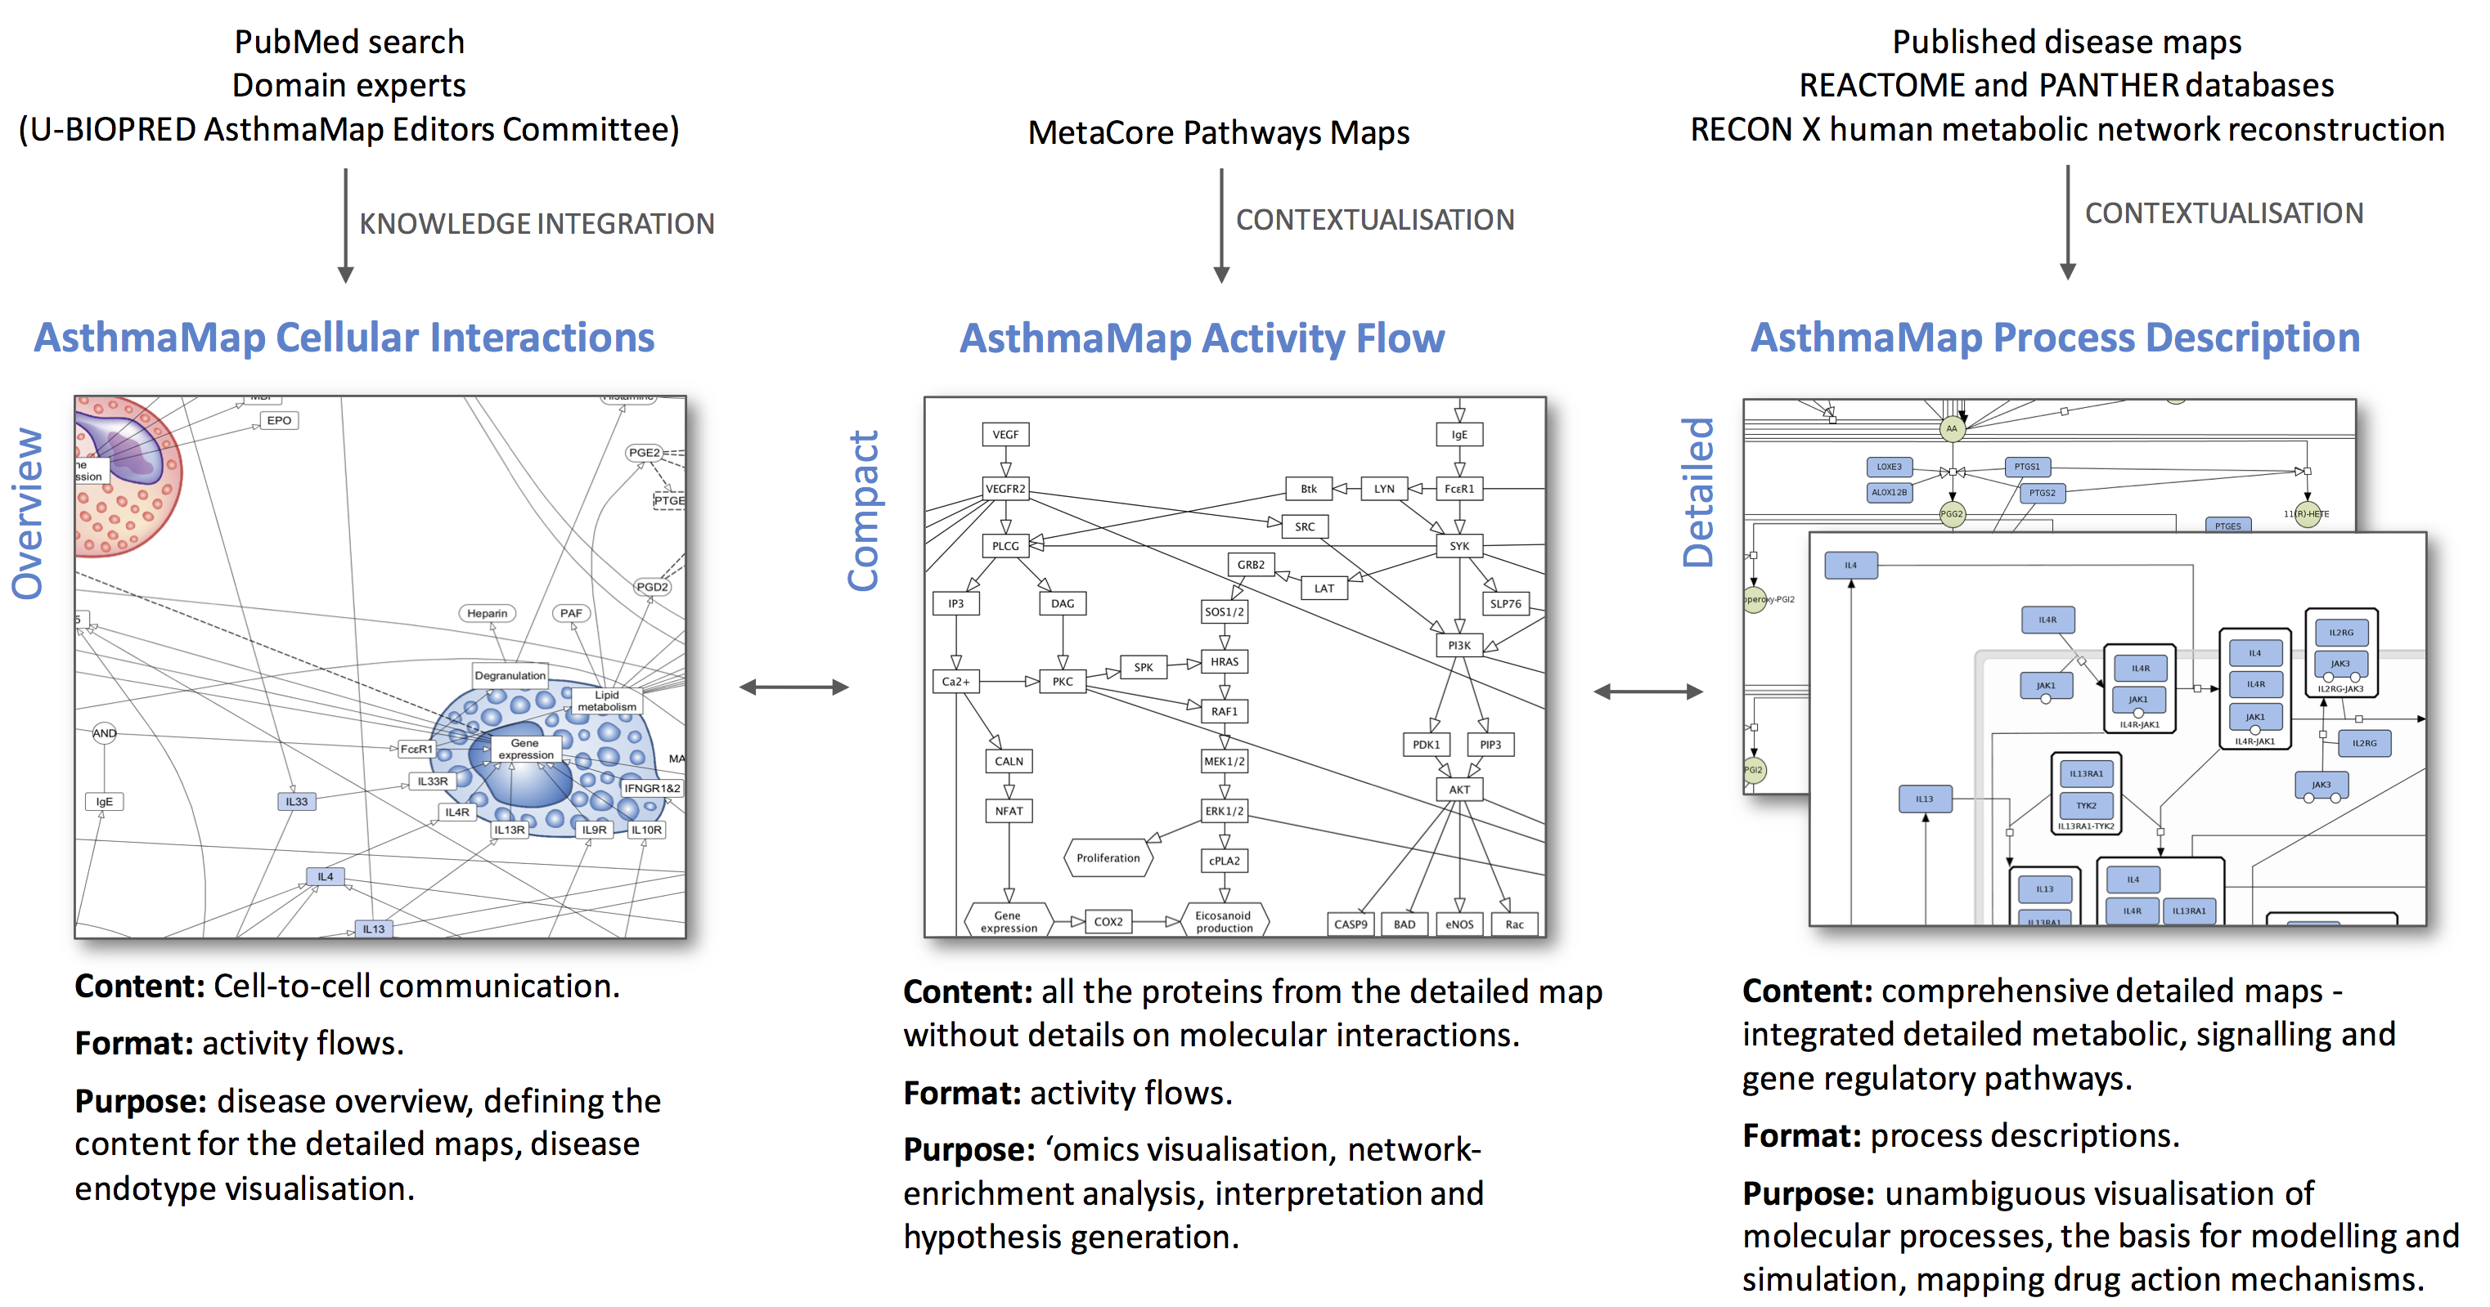
U-BIOPRED AsthmaMap: interconnected layers of granularity

Slide 4
Motivation
To build a software that generates diagrams with automatic network layout and compartment information
1. For AsthmaMap
2. For other disease maps
3. Generic tool for any network

Slide 5
Goals and Objectives
Goal:
Automatic assembly of disease maps, and other networks
Objective:
Create a set of reusable modules (not a task of this internship project)
Merging modules, could be done in excel via python
Automatic layout, resembling human drawn diagrams, for network visualization

Slide 6
Tasks: Types of diagrams to develop
Focus on SBGN Activity Flow Language,
Level 1: AsthmaMap Cellular Interactions
a) 22 cell types with approx 100 entities,
Level 2: AsthmaMap Activity Flow
b) Single cell view with about 200 entities
c) 22 cell types with about 1500 entities (cross it out and explain why)

Slide 7
Plan of Work
Step 1: Use yEd for nested layout
Deliverable 1: code for layout (python code at github, url)
Deliverable 2: code for loading excel files (python code at github, url)
Step 2: Explore other available tools, preferably with nested layout algorithms, such as CerebralWeb, Graphviz,
Step 3: Improve layout algorithms to make it similar to human-drawn diagrams.

Slide 8
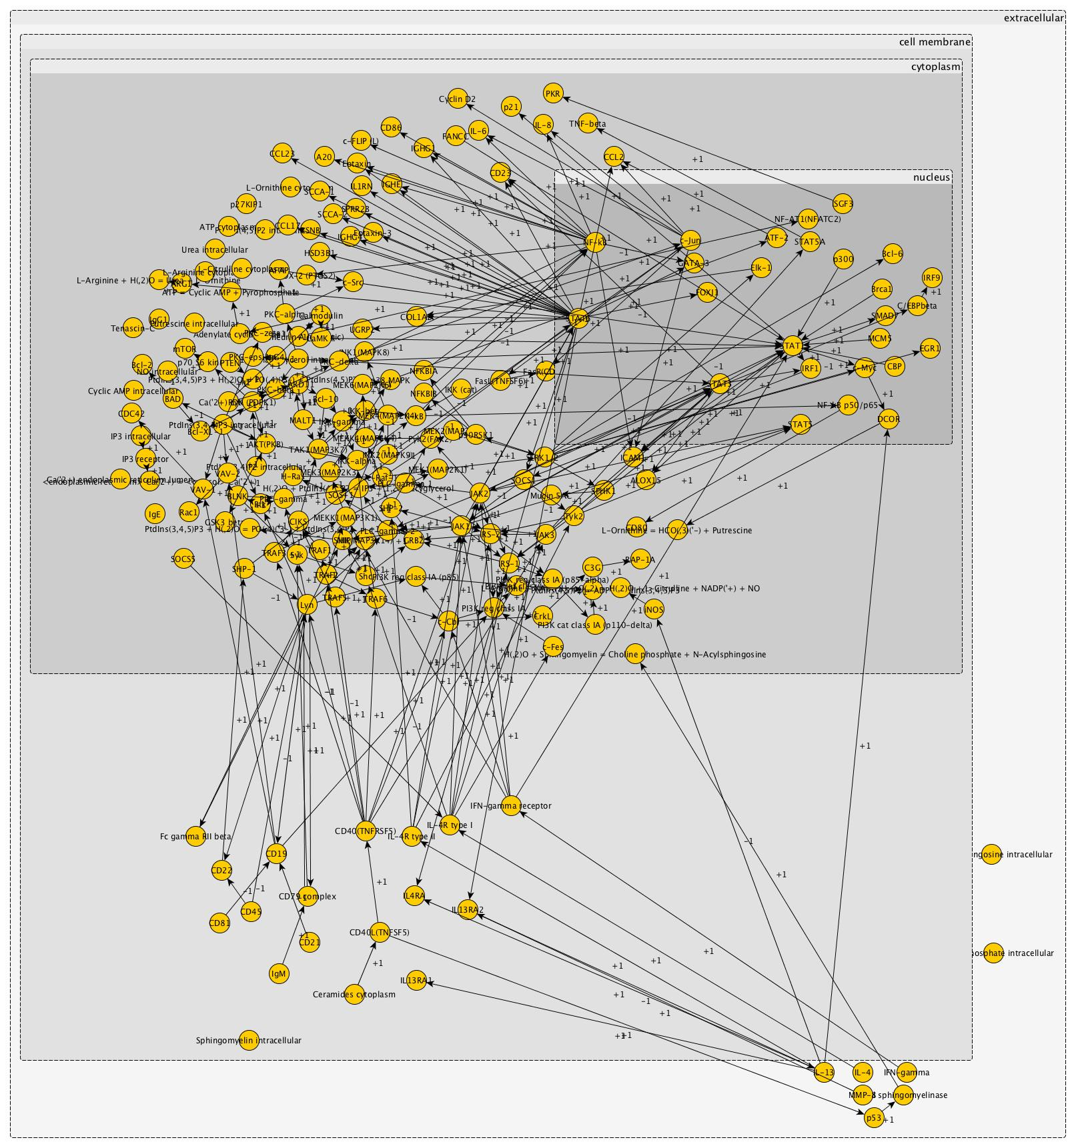
Step 1 results: B cell

Slide 9
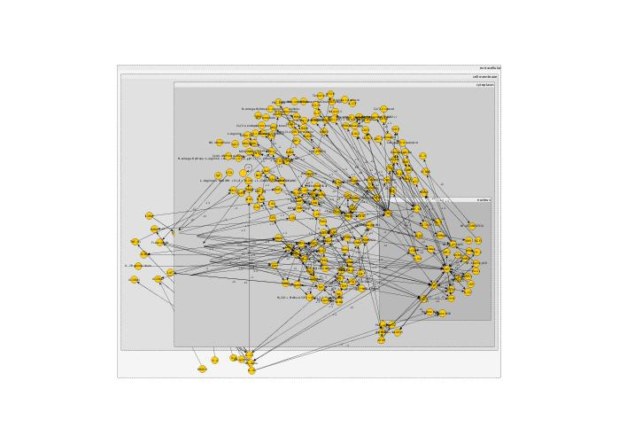
Step 1 results: mast cell example

Slide 10
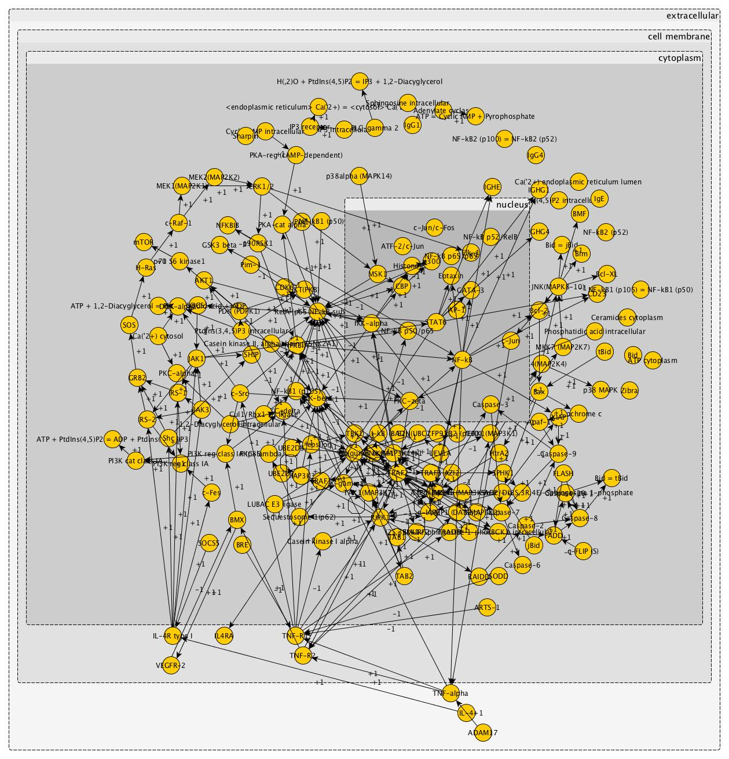
Step 1 results: macrophage example

Slide 11
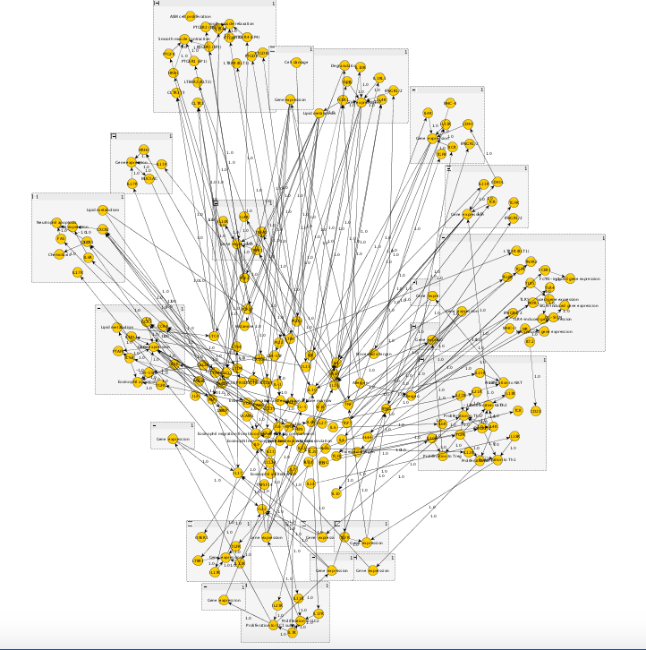
Step 1, level 2 results: 22 cell types

Slide 12
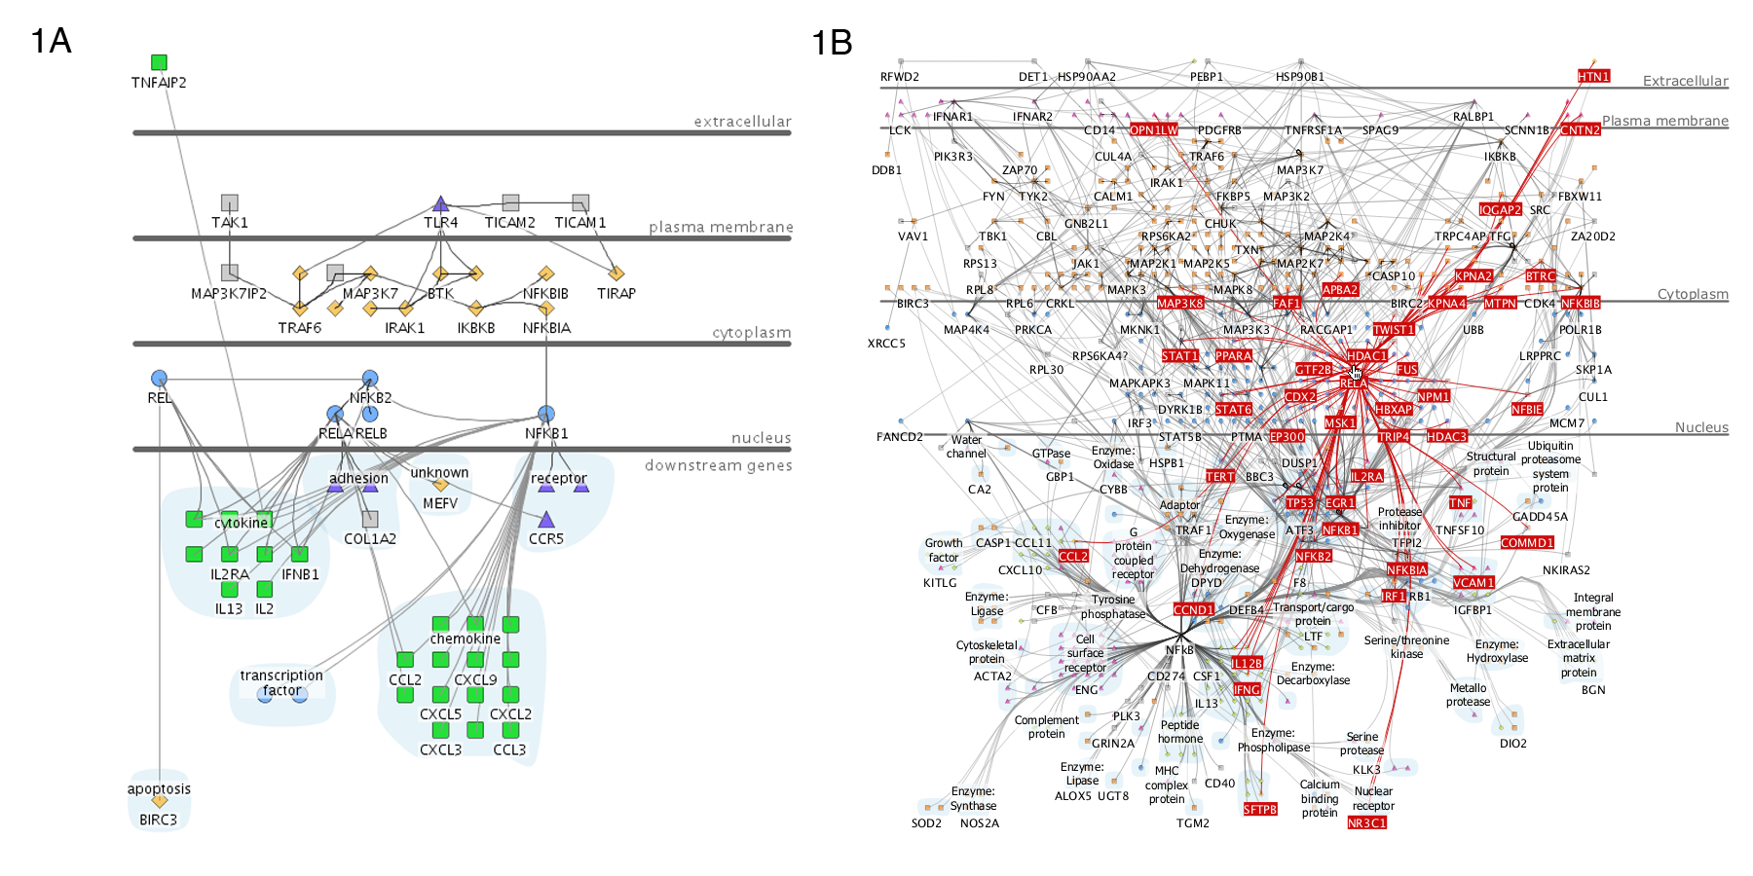
Step 2: Available softwares – CerebralWeb
CerebralWeb is a special plugin for Cytoscape.js that generates a view of a network given the interaction network and subcellular locations.

Slide 13
Step 3: Plans for further development
Explore other tools which generate visual networks with subcellular localisation, like CerebralWeb
Usefulness: This software employs a network layout algorithm that is modeled to emulate hand drawn diagrams.
Caveat: This plugin is light weight web embeddable, hence cannot be used for desktop based applications

Slide 14
Conclusion
Step 1: Use yEd for nested layout
Deliverable 1: code for layout (python code at github, url)
Deliverable 2: code for loading excel files (python code at github, url)
Deliverable 3: GUI for generating maps
Deliverable 4: command line interface for the software
Step 2: Explore other available tools, preferably with nested layout algorithms, such as CerebralWeb, Graphviz,
Deliverable 5: Technical documentation
Step 3: Improve layout algorithms to make it similar to human-drawn diagrams.

Slide 15
My Takeaway
Technical
Introduction to the problems that exist for biological data visualisation
Familiarity with some common tools used in biological data analysis
Learning to make a tool to aid easy network visualisation
General
Working in a computational lab environment
Working with multiple advisors, how to think together

Slide 16

Thank You!

